Slide 1

AllUnite 2026
Liverpool One Mall

Slide 2
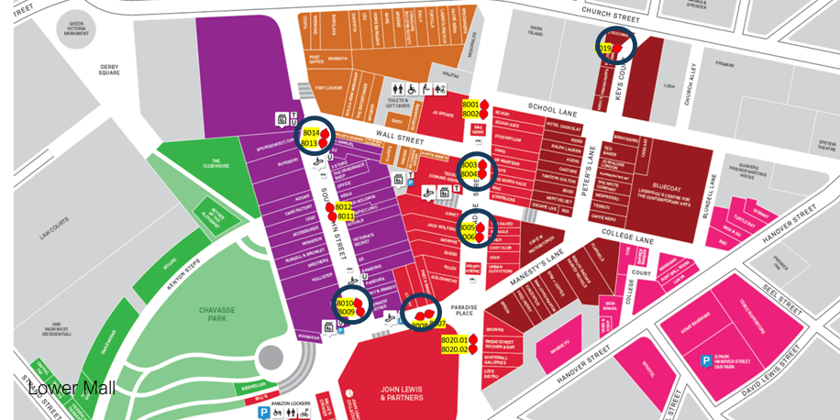
Liverpool One – Lower Mall

Slide 3
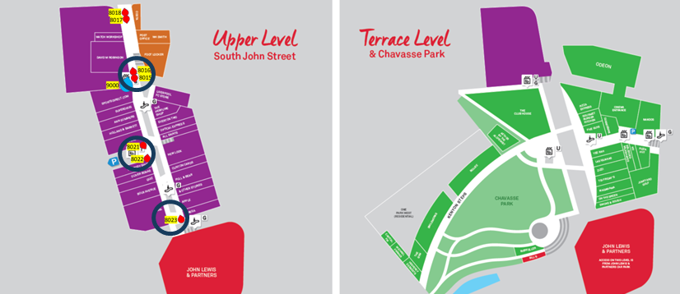
Liverpool One – Upper Mall

